Slide 1
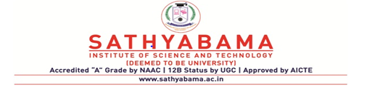
Subject Code: SCS1205 Subject Name: Object Oriented Analysis and Design
Faculty Name: Dr. R. M. Gomathi

Slide 2
Unit - V
Software quality assurance – Testing strategies – Test cases – Test plan – Myers debugging principle – System usability and measuring user satisfaction.

Slide 3
Software Quality Assurance
Quality
It is all about meeting the needs and expectations of customers
Assurance
Provides a guarantee that the product will work without any problems.
Software Quality Assurance (SQA)
Set of activities for ensuring quality in software engineering processes
Part of quality management focused on providing confidence that quality requirements will be fulfilled

Slide 4
Quality Assurance and Quality Control
Quality Assurance (QA) | Quality Control (QC)
Provides assurance that the quality request has been met. | Maintaining standards in manufactured products by testing a sample of the output against the specification.
Goal : To prevent the defects. | Goal : To recognize and fix defects.
Manages the quality-Verification. | Checks the quality-Validation.
It does not include the execution of program | It requires execution of program.
QA is a proactive technique | QC is a reactive technique.
It is a procedure to produce the deliverables | It is a procedure to check those deliverables
It is executed before quality control. | It is executed only after quality assurance activity is completed.
QA is a less time-consuming activity. | QC is a more time-consuming activity.

Slide 5
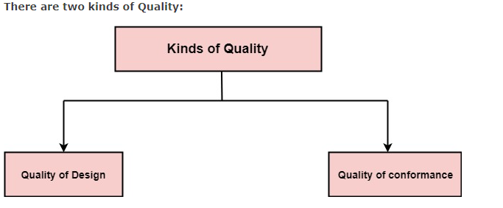
Software quality assurance
Quality defines to any measurable characteristics such as correctness, maintainability, portability, testability, usability, reliability, integrity, reusability, and interoperability.

Slide 6
Quality of Design: Characteristics that designers specify for an item. The grade of materials, tolerances, and performance specifications that all contribute to the quality of design.
Quality of conformance: Degree to which the design specifications are followed during manufacturing. Greater the degree of conformance, the higher is the level of quality of conformance.
Software Quality: Software Quality is defined as meeting the needs and expectations of customers.
Quality Assurance: Quality Assurance is the preventive set of activities that provide greater confidence that the project will be completed successfully.

Slide 7
Definition
Software quality assurance is a planned and systematic plan of all actions necessary to provide adequate confidence that an item or product conforms to establish technical requirements.
A set of activities designed to calculate the process by which the products are developed or manufactured.
SQA Encompasses
A quality management approach
Effective Software engineering technology (methods and tools)
Formal technical reviews that are tested throughout the software process
A multitier testing strategy
Control of software documentation and the changes made to it.
A procedure to ensure compliances with software development standards.

Slide 8
SQA Activities
Variety of functions associated with two different constituencies? the software engineers who do technical work and an SQA group that has responsibility for quality assurance planning, record keeping, analysis, and reporting.
Following activities are performed by an independent SQA group:
1. Prepares an SQA plan for a project:
The program is developed during project planning and is reviewed by all stakeholders.
The plan governs quality assurance activities performed by the software engineering team and the SQA group.
The plan identifies calculation to be performed, audits and reviews to be performed, standards that apply to the project, techniques for error reporting and tracking, documents to be produced by the SQA team, and amount of feedback provided to the software project team.

Slide 9
2. Participates in the development of the project's software process description:
The software team selects a process for the work to be performed.
The SQA group reviews the process description for compliance with organizational policy, internal software standards, externally imposed standards (e.g. ISO-9001), and other parts of the software project plan.
3. Reviews software engineering activities to verify compliance with the defined software process:
The SQA group identifies, reports, and tracks deviations from the process and verifies that corrections have been made.

Slide 10
4. Audits designated software work products to verify compliance with those defined as a part of the software process:
The SQA group reviews selected work products, identifies, documents and tracks deviations, verify that corrections have been made, and periodically reports the results of its work to the project manager.
5. Ensures that deviations in software work and work products are documented and handled according to a documented procedure:
Deviations may be encountered in the project method, process description, applicable standards, or technical work products.
6. Records any noncompliance and reports to senior management:
Non- compliance items are tracked until they are resolved.

Slide 11
QUALITY ASSURANCE TESTS
One reason why quality assurance is needed is because computers are infamous for doing what you tell them to do, not necessarily what you want them to do. To close this gap, the code must be free of errors or bugs that cause unexpected results, a process called debugging..
Scenario-based testing, also called usage-based testing, concentrates on what the user does, not what the product does.
This means capturing use cases and the tasks users perform, then performing them and their variants as tests.
These scenarios also can identify interaction bugs. They often are more complex and realistic than error-based tests.
Scenario-based tests tend to exercise multiple subsystems in a single test, because that is what users do. The tests will not find everything, but they will cover at least the higher visibility system interaction bugs .

Slide 12
TESTING STRATEGIES
The extent of testing a system is controlled by many factors, such as the risks involved, limitations on resources, and deadlines.
In light of these issues, we must deploy a testing strategy that does the "best" job of finding defects in a product within the given constraints.
There are many testing strategies, but most testing uses a combination of these: black box testing, white box testing, top-down testing, and bottom-up testing.
However, no strategy or combination of strategies truly can prove the correctness of a system; it can establish only its "acceptability."

Slide 13

Black Box Testing
It is a software testing method in which the functionalities of software applications are tested without having knowledge of internal code structure, implementation details and internal paths.
Black Box Testing mainly focuses on input and output of software applications and it is entirely based on software requirements and specifications.
It is also known as Behavioral Testing.

Slide 14
Steps for BlackBox Testing
Initially, the requirements and specifications of the system are examined.
Tester chooses valid inputs (positive test scenario) to check whether SUT processes them correctly. Also, some invalid inputs (negative test scenario) are chosen to verify that the SUT is able to detect them.
Tester determines expected outputs for all those inputs.
Software tester constructs test cases with the selected inputs.
The test cases are executed.
Software tester compares the actual outputs with the expected outputs.
Defects if any are fixed and re-tested.

Slide 15
Types of Black Box Testing
There are many types of Black Box Testing but the following are the prominent ones –
Functional testing - This black box testing type is related to the functional requirements of a system; it is done by software testers.
Non-functional testing - This type of black box testing is not related to testing of specific functionality, but non-functional requirements such as performance, scalability, usability.
Regression testing - Regression Testing is done after code fixes, upgrades or any other system maintenance to check the new code has not affected the existing code.

Slide 16
White Box Testing
It is software testing technique in which internal structure, design and coding of software are tested to verify flow of input-output and to improve design, usability and security.
In white box testing, code is visible to testers so it is also called Clear box testing, Open box testing, Transparent box testing,
White box testing involves the testing of the software code for the following:
Internal security holes
Broken or poorly structured paths in the coding processes
The flow of specific inputs through the code
Expected output
The functionality of conditional loops
Testing of each statement, object, and function on an individual basis
Code-based testing and Glass box testing.

Slide 17
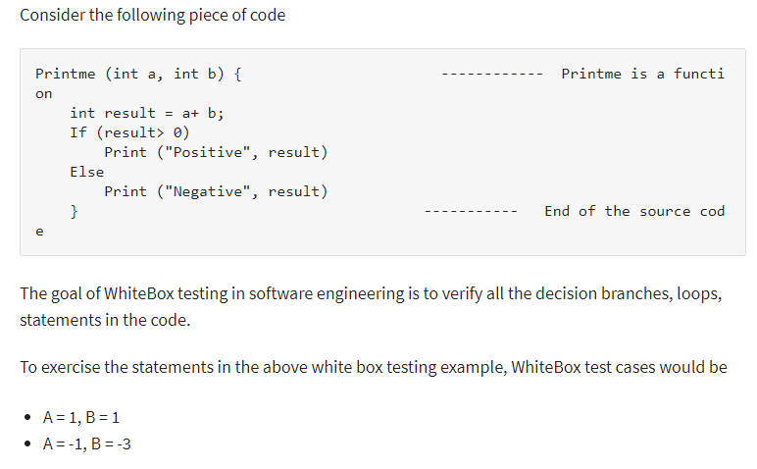
Steps:
1) Understand the Source Code
2) Create Test Cases and Execute

Slide 18
White Box Testing Techniques
Statement Coverage: This technique requires every possible statement in the code to be tested at least once during the testing process of software engineering.
Branch Coverage: This technique checks every possible path (if-else and other conditional loops) of a software application. Using Statement and Branch coverage you generally attain 80-90% code coverage which is sufficient.
Condition Coverage: In this technique, all individual conditions must be covered.
Top-down testing
Top-down testing is a type of incremental Integration testing approach in which testing is done by integrating or joining two or more modules by moving down from top to bottom through control flow of architecture structure.
In these, high-level modules are tested first, and then low-level modules are tested.

Slide 19
Bottom-up testing :
Bottom-up testing is an approach to integrated testing where the lowest level components are tested first, then used to facilitate the testing of higher level components.
The process is repeated until the component at the top of the hierarchy is tested.

Slide 20
Test Cases
To have a comprehensive testing scheme, the test must cover all methods or a good majority of them.
All the services of your system must be checked by at least one test.
To test a system, you must construct some test input cases, then describe how the output will look.

Slide 21
Myers describes the objective of testing as follows. Testing is the process of executing a program with the intent of finding errors.
A good test case is the one that has a high probability of detecting an as-yet undiscovered error. A successful test case is the one that detects an as-yet undiscovered error.
Guidelines for Developing Quality Assurance Test Cases:
Gause and Weinberg provide a wonderful example to highlight the essence of a test case. Say, we want to test our new and improved "Superchalk":
Writing a geometry lesson on a blackboard is clearly normal use for Superchalk. Drawing on clothing is not normal, but is quite reasonable to expect.
Eating Superchalk may be unreasonable, but the design will have to deal with this issue in some way, in order to prevent lawsuits.
No single failure of requirements work leads to more lawsuits than the confident declaration.

Slide 22
Test Plans
On paper, it may seem that everything will fall into place with no preparation and a bug free product will be shipped.
However, in the real world, it may be a good idea to use a test plan to find bugs and remove them. A dreaded and frequently overlooked activity in software development is writing the test plan.
A test plan offers a road map for testing activities, whether usability, user satisfaction, or quality assurance tests.
It should state the test objectives and how to meet them.
The test plan need not be very large; in fact, devoting too much time to the plan can be counterproductive.

Slide 23
Next, perform the tests and compare the outcome with the expected output.
The good news is that the use cases developed during analysis can be used to describe the usage test cases.
After all, tests always should be designed from specifications and not by looking at the product!

Slide 24
Steps needed to create a test plan:
1. Objectives of the test. Create the objectives and describe how to achieve them. For example, if the objective is usability of the system, that must be stated and also how to realize it.
2. Development of a test case. Develop test data, both input and expected output, based on the domain of the data and the expected behaviors that must be tested.
3. Test analysis. This step involves the examination of the test output and the documentation of the test results. If bugs are detected, then this is reported and the activity centers on debugging. After debugging, steps 1 through 3 must be repeated until no bugs can be detected.

Slide 25
All passed tests should be repeated with the revised program, called regression testing, which can discover errors introduced during the debugging process.
When sufficient testing is believed to have been conducted, this fact should be reported, and testing for this specific product is complete .
Guidelines For Developing Test Plans:
The following guidelines have been developed by Thomas for writing test plans.
Whatever the appearance of your test plan, try to include as much detail as possible about the tests. The test plan should contain a schedule and a list of required resources.

Slide 26
List how many people will be needed, when the testing will be done, and what equipment will be required.
After you have determined what types of testing are necessary (such as black box, white box, top-down, or bottom-up testing), you need to document specifically what you are going to do. Document every type of test you plan to complete.
MYERS'S DEBUGGING PRINCIPLES
The Myers's bug location and debugging principles:
1. Bug Locating Principles . Think. . If you reach an impasse, sleep on it. . If the impasse remains, describe the problem to someone else.
.Use debugging tools (this is slightly different from Myers's suggestion). .Experimentation should be done as a last resort (this is slightly different from Myers's suggestion).

Slide 27
2. Debugging Principles . Where there is one bug, there is likely to be another. .Fix the error, not just the symptom of it.
The probability of the solution being correct drops as the size of the program increases.
Beware of the possibility that an error correction will create a new error (this is less of a problem in an object-oriented environment).
Eg:CASE STUDY: DEVELOPING TEST CASES FOR THE VIANET BANK ATM SYSTEM

Slide 28
System Usablility and User Satisfaction :
USABILITY TESTING The International Organization for Standardization (ISO) defines usability as the effectiveness, efficiency; and satisfaction with which a specified set others can achieve a specified set of tasks in particular environments.
The ISO definition requires
Defining tasks. What are the tasks? .
Defining users. Who are the users?
A means for measuring effectiveness, efficiency, and satisfaction. How do we measure usability?

Slide 29
The phrase two sides of the same coin is helpful for describing the relationship between the usability and functionality of a system.
Both are essential for the development of high-quality software .
Usability testing measures the ease of use as well as the degree of comfort and satisfaction users have with the software.
Products with poor usability can be difficult to learn, complicated to operate, and misused or not used at all.
Therefore, low product usability leads to high costs for users and a bad reputation for the developers.
Usability is one of the most crucial factors in the design and development of a product, especially the user interface. Therefore, usability testing must be a key part of the UI design process.

Slide 30
Usability testing should begin in the early stages of product development; for example, it can be used to gather information about how users do their work and find out their tasks, which can complement use cases.
You can incorporate your findings into the usability test plan and test cases.
As the design progresses, usability testing continues to provide valuable input for analyzing initial design concepts and, in the later stages of product development, can be used to test specific product tasks, especially the ill.

Slide 31
Usability test cases begin with the identification of use cases that can specify the target audience, tasks, and test goals.
When designing a test, focus on use cases or tasks, not features.
Even if your goal is testing specific features, remember that your users will use them within the context of particular tasks.
It also is a good idea to run a pilot test to work the bugs out of the tasks to be tested and make certain the task scenarios, prototype, and test equipment work smoothly.
Test cases must include all use cases identified so far. Recall from Previous chapter that the use case can be used through most activities of software development.

Slide 32
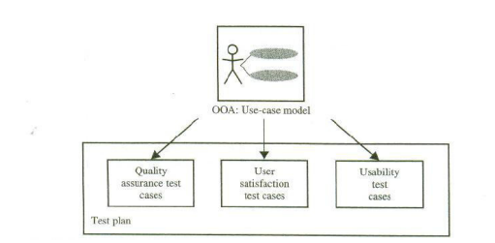
Furthermore, by following Jacobson's life cycle model, you can produce designs that are traceable across requirements, analysis, design, implementation, and testing.
The main advantage is that all design traces directly back to the user requirements.
Use cases and usage scenarios can become test scenarios; and therefore, the use case will drive the usability, user satisfaction, and quality assurance test cases .

Slide 33
The use cases identified during analysis can be used in testing the design. Once the design is complete, walk users through the steps of the scenarios to determine if the design enables the scenarios to occur as planned.
Guidelines for Developing Usability Testing
Many techniques can be used to gather usability information.
In addition to use cases,focus groups can be helpful for generating initial ideas or trying out new ideas. A focus group requires a moderator who directs the discussion about aspects of a task or design but allows participants to freely express their opinions.

Slide 34
Usability tests can be conducted in a one-on-one fashion, as a demonstration, or as a "walk through," in which you take the users through a set of sample scenarios and ask about their impressions along the way.
In a technique called the Wizard of OZ, a testing specialist simulates the interaction of an interface.
Although these latter techniques can be valuable, they often require a trained, experienced test coordinator 9.
Let us take a look at some guidelines for developing usability testing: .
The usability testing should include of a software's components. .
Usability testing need not be very expensive or elaborate, such as including trained specialists working in a soundproof lab with one-way mirrors and sophisticated recording equipment. Even the small investment of tape recorder, stopwatch, and notepad in an office or conference room can produce excellent results.

Slide 35
Similarly, all tests need not involve many subjects.
More typically, quick, iterative tests with a small, well-targeted sample of 6 to 10 participants can identify 80-90 percent of most design problems.
Consider the user's experience as part of your software usability.
You can study 80-90 percent of most design problems with as few as three or four users if you target only a single skill level of users, such as novices or intermediate level users.

Slide 36
Recording the Usability Test:
When conducting the usability test, provide an environment comparable to the target setting; usually a quiet location, free from distractions is best. Make participants feel comfortable.
It often helps to emphasize that you are testing the software, not the participants.
If the participants become confused or frustrated, it is no reflection on them.
Unless you have participated yourself, you may be surprised by the pressure many test participants feel. You can alleviate some of the pressure by explaining the testing process and equipment.
Tandy Trower, director of the Advanced User Interface group at Microsoft, explains that the users must have reasonable time to try to work through any difficult situation they encounter.
Although it generally is best not to interrupt participants during a test, they may get stuck or end up in situations that require intervention.

Slide 37
This need not disqualify the test data, as long as the test coordinator carefully guides or hints around a problem.
Begin with general hints before moving to specific advice.
For more difficult situations, you may need to stop the test and make adjustments. Keep in mind that less intervention usually yields better results.
Always record the techniques and search patterns users employ when attempting to work through a difficulty and the number and type of hints you have to provide them.

Slide 38
Ask subjects to think aloud as they work, so you can hear what assumptions and inferences they are making. As the participants work, record the time they take to perform a task as well as any problems they encounter.
You may want to follow up the session with the user satisfaction test (more on this in the next section) and a questionnaire that asks the participants to evaluate the product or tasks they performed.
Record the test results using a portable tape recorder or, better, a video camera.Since even the best observer can miss details, reviewing the data later will prove invaluable.
Recorded data also allows more direct comparison among multiple participants. It usually is risky to base conclusions on observing a single subject. Recorded data allows the design team to review and evaluate the results.

Slide 39
Whenever possible, involve all members of the design team in observing the test and reviewing the results.
This ensures a common reference point and better design solutions as team members apply their own insights to what they observe.
If direct observation is not possible, make the recorded results available to the entire team.
To ensure user satisfaction and therefore high-quality software, measure user satisfaction along the way as the design takes form .

Slide 40
User Satisfaction Test:
A positive side effect of testing with a prototype is that you can observe how people actually use the software.
In addition to prototyping and usability testing, another tool that can assist us in developing high-quality software is measuring and monitoring user satisfaction during software development, especially during the design and development of the user interface.

Slide 41
User Satisfaction Test
User satisfaction testing is the process of quantifying the usability test with some measurable attributes of the test, such as functionality, cost, or ease of use.
Usability can be assessed by defining measurable goals, such as .95 percent of users should be able to find how to withdraw money from the ATM machine without error and with no formal training.
70 percent of all users should experience the new function as "a clear improvement over the previous one."
90 percent of consumers should be able to operate the VCR within 30 minutes. Furthermore, if the product is being built incrementally, the best measure of user satisfaction is the product itself, since you can observe how users are using it-or avoiding it

Slide 42
Gause and Weinberg have developed a user satisfaction test that can be used along with usability testing. Here are the principal objectives of the user satisfaction test .
As a communication vehicle between designers, as well as between users and designers. .To detect and evaluate changes during the design process.
.To provide a periodic indication of divergence of opinion about the current design. .To enable pinpointing specific areas of dissatisfaction for remedy. .
To provide a clear understanding of just how the completed design is to be evaluated.
Even if the results are never summarized and no one fills out a questionnaire, the process of creating the test itself will provide useful information.
Additionally, the test is inexpensive, easy to use, and it is educational to both those who administer it and those who take it.

Slide 43
Guidelines For Developing A User Satisfaction Test :
The format of every user satisfaction test is basically the same, but its content is different for each project.
Once again, the use cases can provide you with an excellent source of information throughout this process.
Furthermore, you must work with the users or clients to find out what attributes should be included in the test.
Ask the users to select a limited number (5 to 10) of attributes by which the final product can be evaluated.
For example, the user might select the following attributes for a customer tracking system: ease of use, functionality, cost, intuitiveness of user interface, and reliability

Slide 44
Once these attributes have been identified, they can playa crucial role in the evaluation of the final product.
Keep these attributes in the foreground, rather than make assumptions about how the design will be evaluated .
The user must use his or her judgment to answer each question by selecting a number between 1 and 10, with 10 as the most favorable and 1 as the least.
Comments often are the most significant part of the test. Gause and Weinberg raise the following important point in conducting a user satisfaction test :
"When the design of the test has been drafted, show it to the clients and ask, 'If you fill this out monthly (or at whatever interval), will it enable you to express what you like and don't like?' If they answer negatively then find out what attributes would enable them to express themselves and revise the test."

Slide 45
A Tool for Analyzing User Satisfaction: The User Satisfaction Test Template.
Commercial off-the-shelf (COTS) software tools are already written and a few are available for analyzing and conducting user satisfaction tests.
However, here, I have selected an electronic spreadsheet to demonstrate how it can be used to record and analyze the user satisfaction test.
The user satisfaction test spreadsheet (USTS) automates many bookkeeping tasks and can assist in analyzing the user satisfaction test results.
Furthermore, it offers a quick start for creating a user satisfaction test for a particular project.

Slide 46
Recall from the previous section that the tests need not involve many subjects.
More typically, quick, iterative tests with a small, well-targeted sample of 6 to 10 participants can identify 80-90 percent of most design problems.
The spreadsheet should be designed to record responses from up to 10 users. However, if there are inputs from more than 10 users, it. must allow for that.
One use of a tool like this is that it shows patterns in user satisfaction level.
For example, a shift in the user satisfaction rating indicates that something is happening.

Slide 47
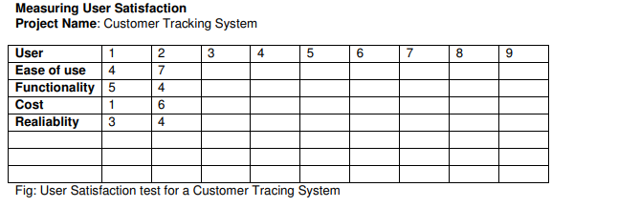

Slide 48
Periodical plotting can reveal shifts in user satisfaction, which can pinpoint a problem-Plotting the high and low responses indicates where to go for maximum information (Gause and Weinberg) finding out what attributes are important or unimportant.
An interesting side effect of developing a user satisfaction test is that you benefit from it even if the test is never administered to anyone; it still provides useful information.
However, performing the test regularly helps to keep the user involved in the system.
It also helps you focus on user wishes. Here is the user satisfaction cycle that has been suggested by Gause and Weinberg:

Slide 49
1. Create a user satisfaction test for your own project. Create a custom form that fits the project's needs and the culture of your organization.
Use cases are a great source of information; however, make sure to involve the user in creation of the test.
2. Conduct the test regularly and frequently.
3. Read the comments very carefully, especially if they express a strong feeling. Never forget that feelings are facts, the most important facts you have about the users of the system.
4. Use the information from user satisfaction test, usability test, reactions to prototypes, interviews recorded, and other comments to improve the product.

Slide 50
Another benefit of the user satisfaction test is that you can continue using it even after the product is delivered.
The results then become a measure of how well users are learning to use the product and how well it is being maintained.
They also provide a starting point for initiating follow-up projects.
CASE STUDY: DEVELOPING USABILITY TEST PLANS AND TEST CASES FOR THE VIANET BANK ATM SYSTEM

Slide 51
DEVELOP TEST OBJECTIVES
The first step is to develop objectives for the test plan. Generally, test objectives are based on the requirements, use cases, or current or desired system usage.
In this case, ease of use is the most important requirement, since the ViaNet bank customers should be able to perform their tasks with basically no training and are not expected to read a user manual before withdrawing money from their checking accounts.
Here are the objectives to test the usability of the ViaNet bank ATM kiosk and its user interface: 95 percent of users should be able to find out how to withdraw money from the ATM machine without error or any formal training. .90 percent of consumers should be able to operate the ATM within 90 seconds.

Slide 52
DEVELOP TEST CASES
Test cases for usability testing are slightly different from test cases for quality assurance.
Basically, here, we are not testing the input and expected output but how users interact with the system.
Once again, the use cases created during analysis can be used to develop scenarios for the usability test. The usability test scenarios are based on the following use cases:

Slide 53
Start by explaining the testing process and equipment to the participants to ease the pressure. Remember to make participants feel comfortable by emphasizing that you are testing the software, not them.
If they become confused or frustrated, it is no reflection on them but the poor usability of the system.
Make sure to ask them to think aloud as they work, so you can hear what assumptions and inferences they are making.
After all, if they cannot perform these tasks with ease, then the system is not useful.

Slide 54
As the participants work, record the time they take to perform a task as well as any problems they encounter.
In this case, we used the kiosk video...camera to record the test results along with a tape recorder.
ANALYZE THE TESTS
The final step is to analyze the tests and document the test results.
Here, we need to answer questions such as these: What percentage were able to operate the ATM within 90 seconds or without error? Were the participants able to find out how to withdraw money from the ATM machine with no help? The results of the analysis must be examined.

Slide 55
We also need to analyze the results of user satisfaction tests.
The USTS described earlier or a tool similar to it can be used to record and graph the results of user satisfaction tests.
As we learned earlier, a shift in user satisfaction pattern indicates that something is happening and a follow-up interview is needed to find out the reasons for the changes.
The user satisfaction test can be used as a tool for finding out what attributes are important or unimportant. For example, based 011 the user satisfaction test, we might find that the users do not agree that the system "is efficient to use," and it got a low score.

Slide 56
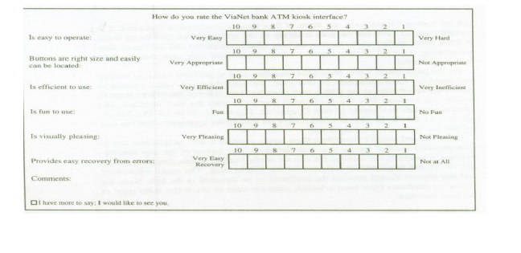
After the follow-up interviews, it became apparent that participants wanted, in addition to entering the amount for withdrawal, to be able to select from a list with predefined values (say, $20, $40).

Slide 57
THANK YOU

